Slide 1
NuGet & MSBuild
Dushyant Priyadarshee

Slide 2
Pre-requisites
MSBuild
Dotnet
NuGet

Slide 3
SDK Style csproj advantages
Less clutter
Generate NuGet package on build
Toolset improvements
Perform dotnet restore or msbuild /t:restore
Auto reload

Slide 4
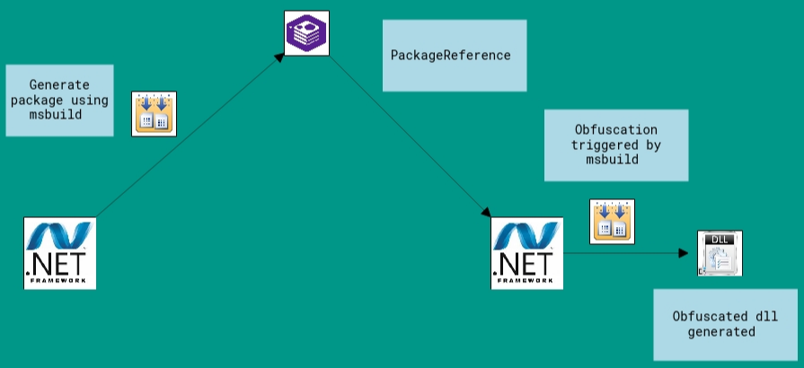
Demo
.Net Framework
SDK Style csproj
NuGet

Slide 5
NuGet & MSBuild
<GeneratePackageOnBuild>true</GeneratePackageOnBuild> https://docs.microsoft.com/en-us/nuget/quickstart/create-and-publish-a-package-using-the-dotnet-cli#automatically-generate-package-on-build
NuGet package folder structure https://docs.microsoft.com/en-us/nuget/create-packages/creating-a-package#from-a-convention-based-working-directory
MSBuild props and targets in nupkg
<IncludeBuildOutput>false</IncludeBuildOutput> https://docs.microsoft.com/en-us/nuget/reference/msbuild-targets#packing-using-a-nuspec
Packaging and using tools in nupkg https://github.com/yck1509/ConfuserEx https://www.nuget.org/packages/ConfuserEx.Final/

Slide 6
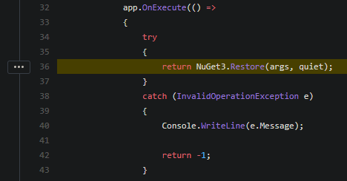
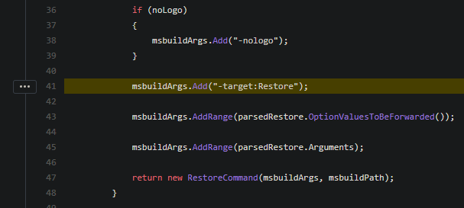
MSBuild & dotnet build
https://github.com/dotnet/cli/blob/6cde21225e18fc48eeab3f4345ece3e6bb122e53/src/dotnet/commands/dotnet-restore/Program.cs#L36
https://github.com/dotnet/sdk/blob/master/src/Cli/dotnet/commands/dotnet-restore/Program.cs#L41

Slide 7
Recommendations
Migrate to sdk style csproj
Use MSBuild if code base is .Net Framework or mix of core/standard and framework, else use dotnet.
Migrate to core/standard where possible
Avoid using multiple tools, msbuild, dotnet and nuget. Very likely you can use just one of those.

Slide 8
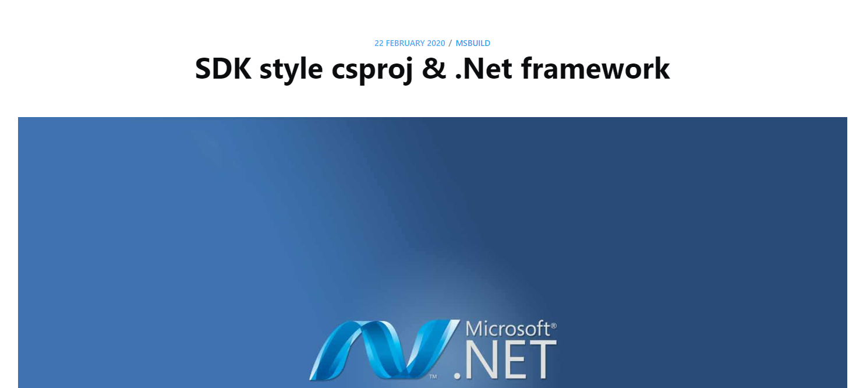
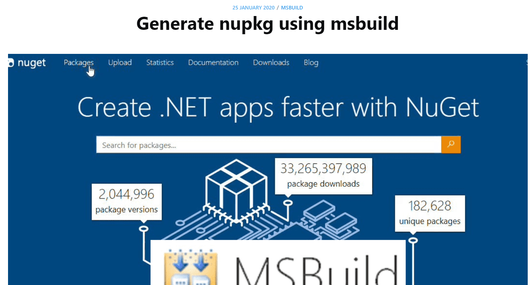

Extra – blog posts & repo
https://www.rubberduckdev.com/sdkstyle-framework-csproj/
https://www.rubberduckdev.com/msbuild-nuget/
https://github.com/realrubberduckdev/NuGetAndMSBuild

Slide 9
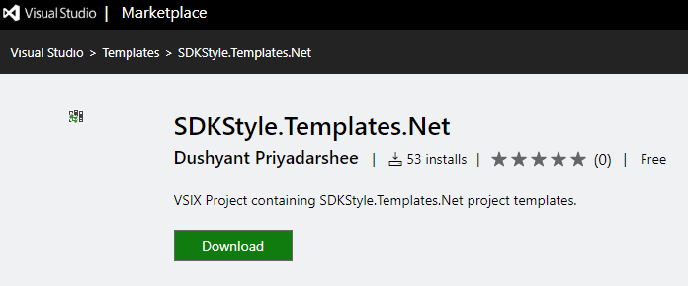
Extra - SDK Style csproj for .Net Framework
Create dotnet core/standard project and change target framework
SDKStyle.Templates.Net https://marketplace.visualstudio.com/items?itemName=rubberduckdev.SDKStyleTemplatesNet

Slide 10
Thank you
Thoughts, comments, questions welcome. Here or on twitter.

